Slide 1

How good is my GAN? (ECCV 2018)

Slide 2
Directory
01
02
03
Significance
Content
Experiment

Slide 3
01
Significance

Slide 4
Generative Adversarial Networks (GANs) have been exploited with some success in several computer vision problems, such as text-to-image and image-to-image translation , super-resolution, and realistic natural image. Since the original GAN model was proposed, many variants have appeared in the past few years. How can these models be evaluated and compared to each other ?
Why is it important?
(1)To help the practitioner choose a better algorithm
(2)To make progress towards better algorithms and their understanding

Slide 5
02
Content

Slide 6
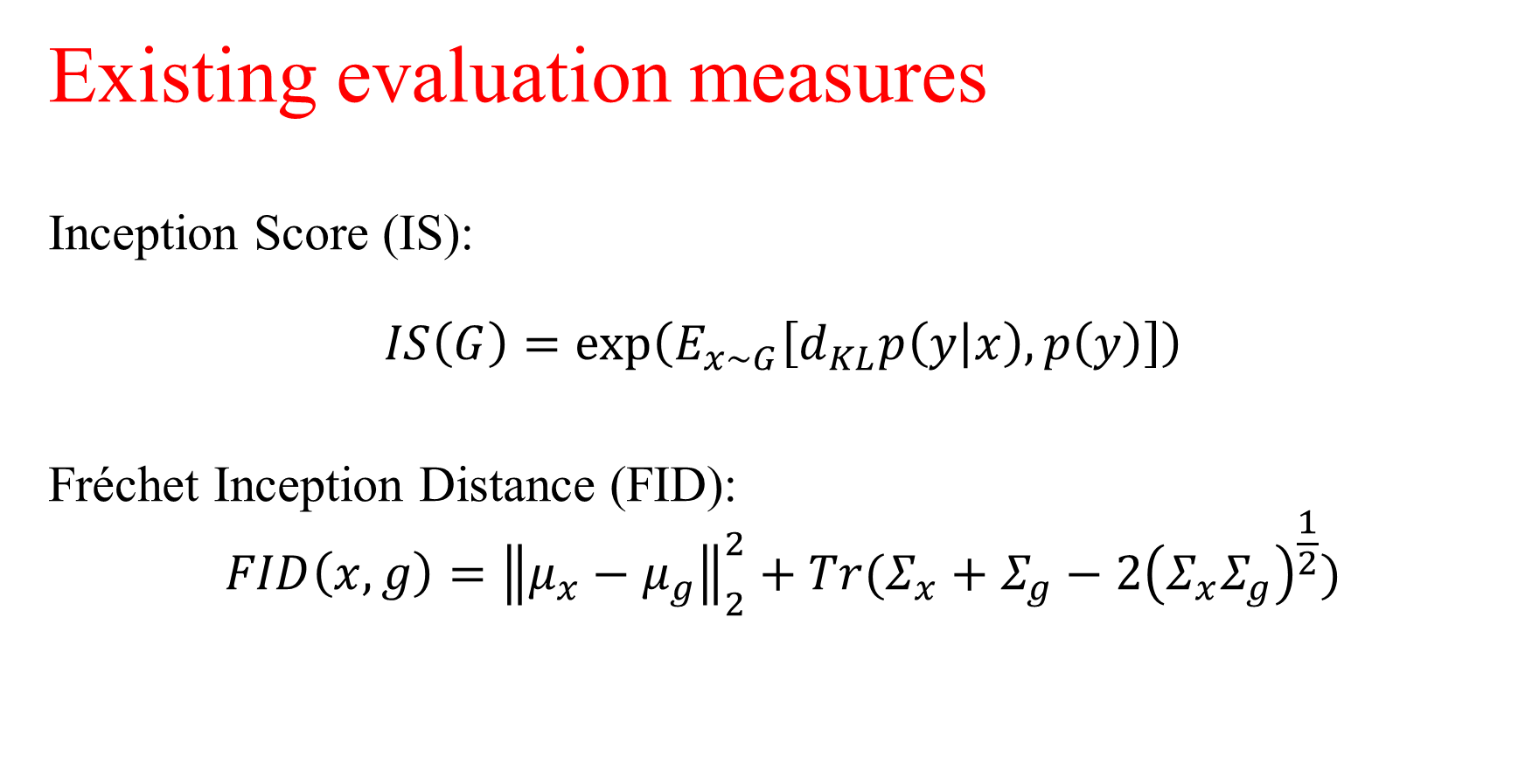
Existing evaluation measures
Inception Score (IS):
$$IS\left(G\right)=\exp\left(E_{x\sim G}\left[d_{KL}p\left(y | x\right),p\left(y\right)\right]\right)$$
Fréchet Inception Distance (FID):
$$FID\left(x,g\right)={\left\|μ_{x}−μ_{g}\right\|}_{2}^{2}+Tr(Σ_{x}+Σ_{g}−2{\left(Σ_{x}Σ_{g}\right)}^{\frac{1}{2}})$$

Slide 7
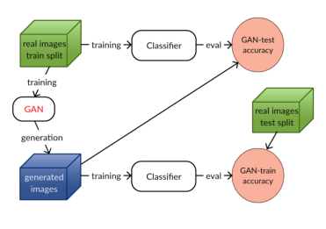
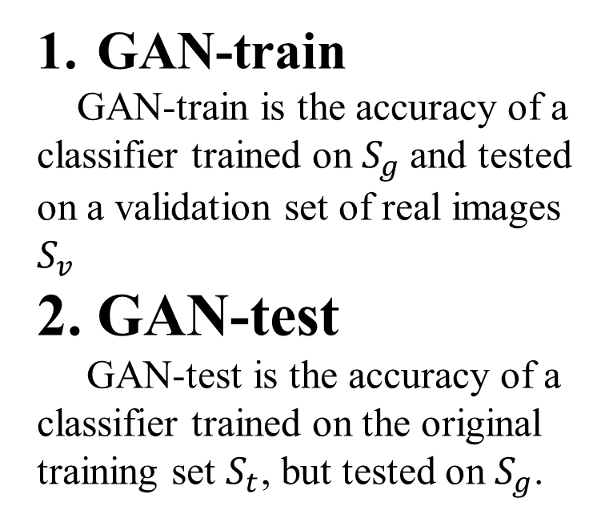
The measures proposed in this paper
GAN-train
GAN-train is the accuracy of a classifier trained on $S_{g}$and tested on a validation set of real images $S_{v}$
2. GAN-test
GAN-test is the accuracy of a classifier trained on the original training set $S_{t}$, but tested on $S_{g}$.
Illustration of GAN-train and GAN-test

Slide 8
03
Experiment

Slide 9
Related work
Datasets
MNIST、CIFAR10、CIFAR100、 ImageNet1k
GAN models
WGAN、SNGAN、DCGAN、PixelCNN++

Slide 10
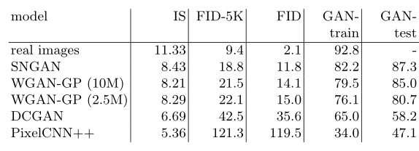
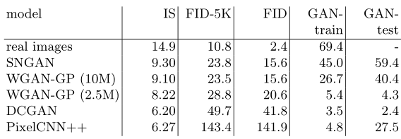
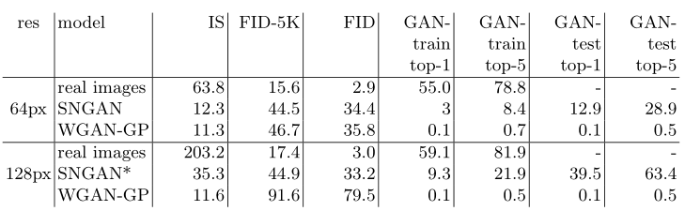
CIFAR10 experiments
CIFAR100 experiments
ImageNet experiments

Slide 11
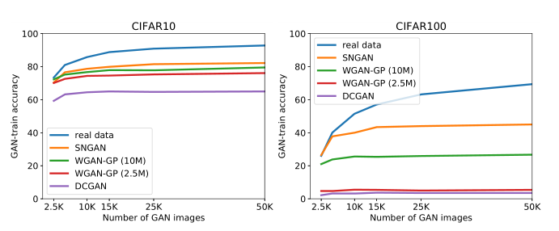
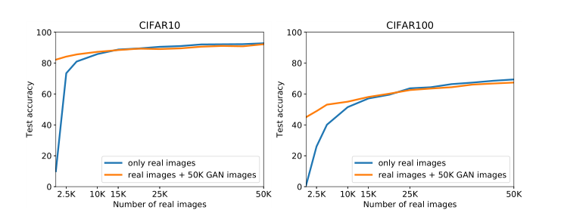
GAN image diversity
The effect of varying the size of the generated image set on GAN-train accuracy.
The impact of training a classifier with a combination of real and SNGAN generated images.

Slide 12
THANKS

